Slide 1
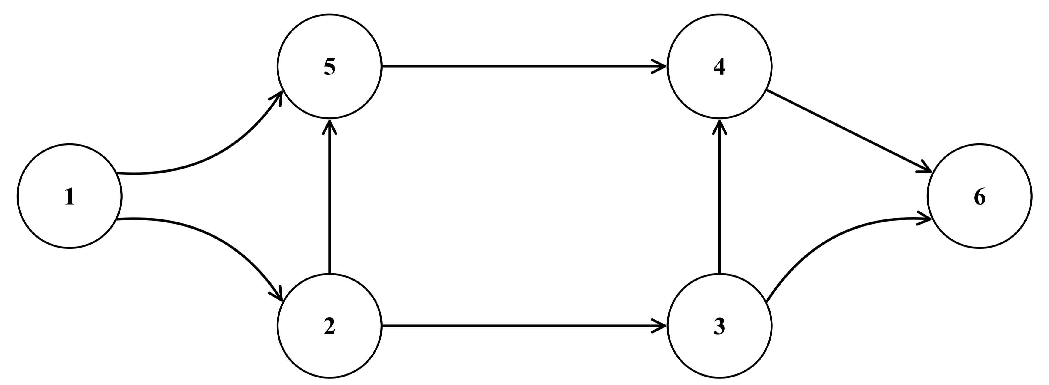
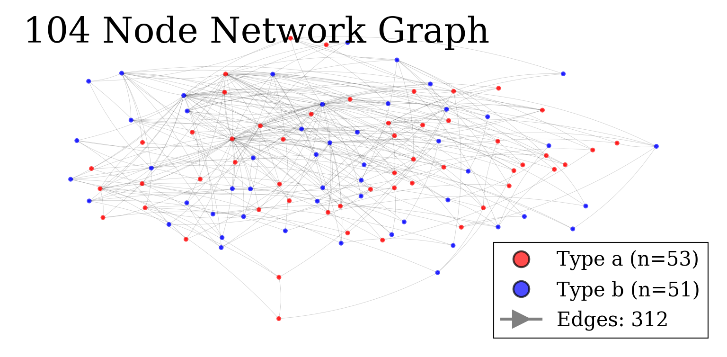
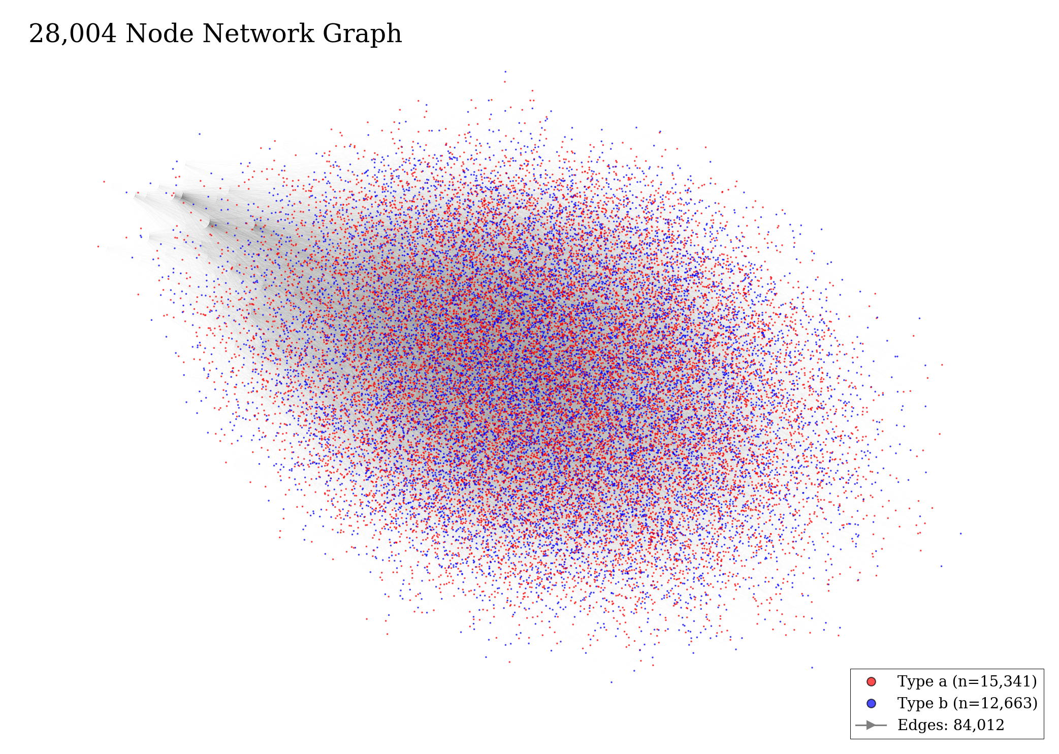
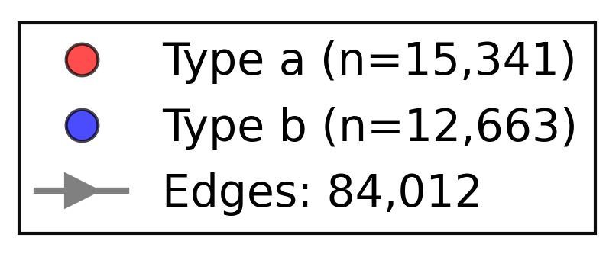
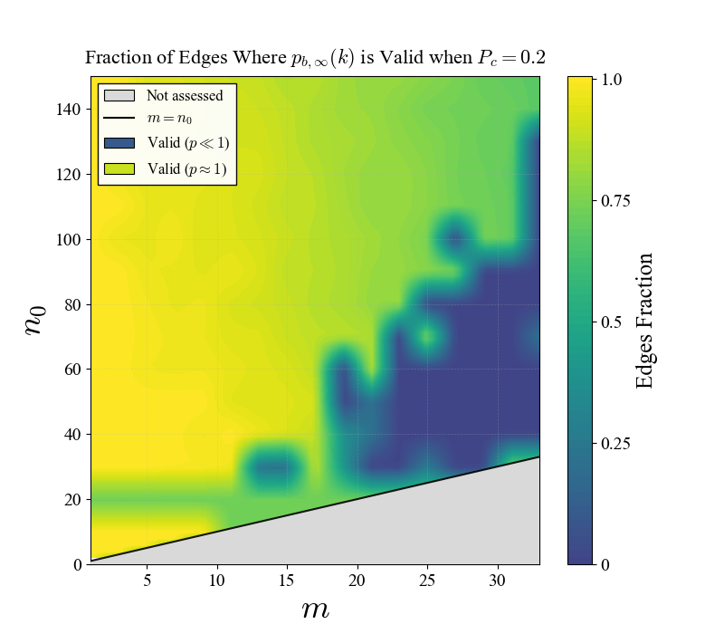
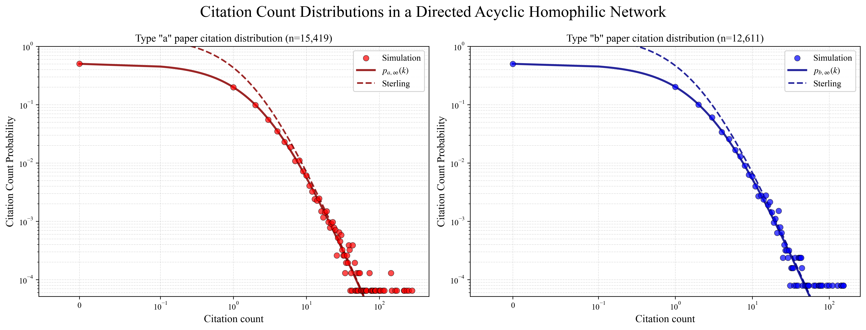
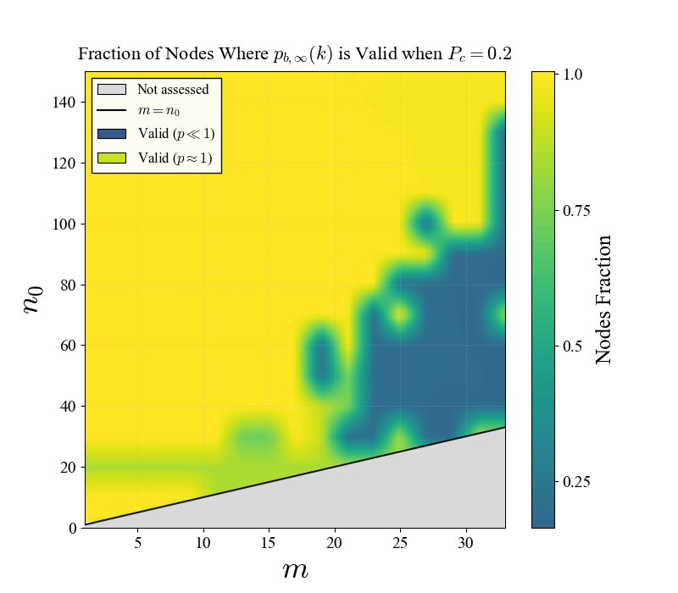
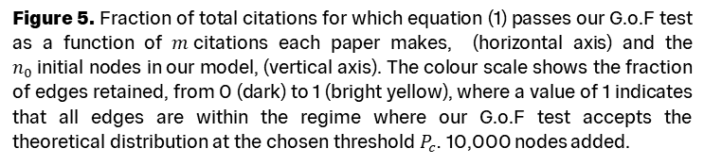
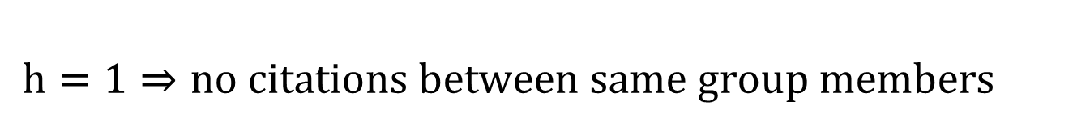
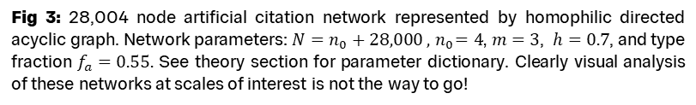
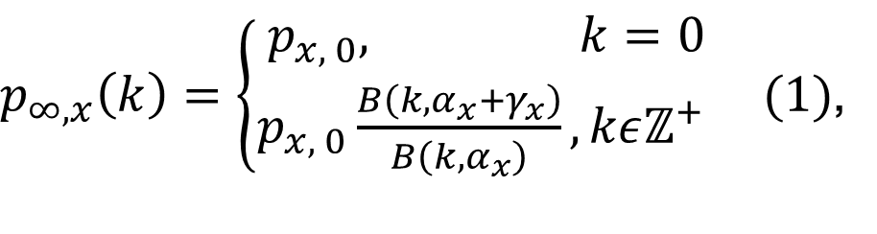
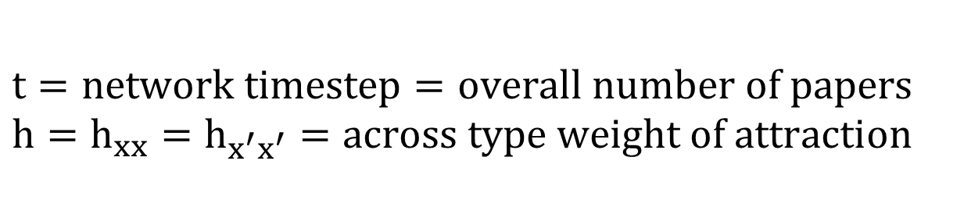
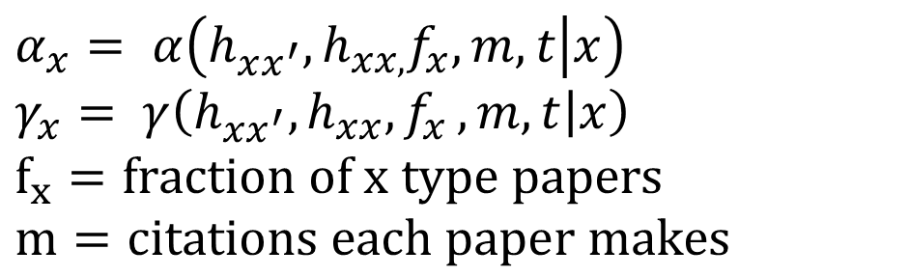
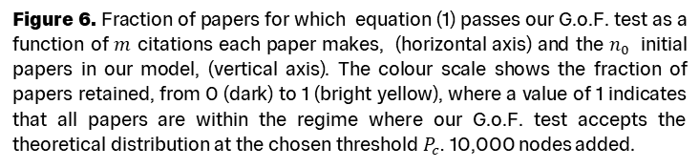
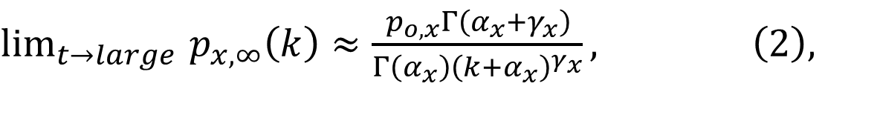
The Science of Quantifying Innovation
Theoretical Physics Group
Sid Diamond
Supervisor: Tim Evans
Background
How likely is it that a string theory paper receives 100 citations? How does this likelihood change if the researcher is female or otherwise? What if the paper is written in English or otherwise? Predictive insight into a network’s topology allows us to locate its inefficiencies and non-level playing fields. What can this tell us about how we quantify innovation?
We derive a new equation for the probability that a node of a given type has a given citation count by adapting the Price model [1] for a homophilic directed acyclic graph (DAG). Using an asymptotic convergence approximation, our result is a distribution modelled by Beta functions (1) that, under Sterling’s approximation, becomes the literature convention, and in our case less accurate, power law distribution.
We also provide a new statistical recipe for the goodness of fit (G.o.F) of our result that accounts for the challenging statistics of our simulated networks.
Fig 1: Directed acyclic graph (DAG) diagram containing 6 nodes, labelled from one to six. Directed edges connect the nodes.
Fig 2: 104 node artificial citation network represented by homophilic directed acyclic graph. Network parameters: $N=n_{0}+100 , { n}_{0}=4$,$m=3$, $h=0.7$, and type fraction $f_{a}=0.55.$ See theory section for parameter dictionary.
A citation between two papers is constrained to pointing backwards in time. A newer paper cites a preexisting one. By representing, as nodes, all the papers and representing, as directed edges, all the citations in a database, we can construct a DAG representation of our network.
Fig 3: 28,004 node artificial citation network represented by homophilic directed acyclic graph. Network parameters: $N=n_{0}+28,000 , { n}_{0}=4$,$m=3$, $h=0.7$, and type fraction $f_{a}=0.55.$ See theory section for parameter dictionary. Clearly visual analysis of these networks at scales of interest is not the way to go!
Theory
$p_{∞,x}\left(k\right)=\left\{\begin{aligned}p_{x, 0}, k=0 \\ &p_{x, 0}\frac{B\left(k, α_{x}+γ_{x}\right)}{B\left(k, α_{x}\right)}, kεℤ^{+} \end{aligned} (1)\right.$,
$\lim_{t→large }{p_{x,∞}\left(k\right)≈\frac{p_{o,x}Γ\left(α_{x}+γ_{x}\right)}{Γ\left(α_{x}\right){\left(k+α_{x}\right)}^{γ_{x}}}, \left(2\right),}$
(1) Is the probability a paper of type $x \text{has} k \text{citations}\text{. (}\text{2}\text{) }\text{is} \text{this} \text{distribution} \text{transformed} \text{into} \text{the} \text{literature} \text{convention} \text{power} \text{law} \text{distribution}$form using Sterling’s approximation.
$$α_{x}= α\left(h_{xx^{′}}, h_{xx,}f_{x}, m, t | x\right)$$
$$γ_{x}= γ\left(h_{xx^{′}}, h_{xx}{,f}_{x}, m, t | x\right)$$
$f_{x}=fraction of x type papers$
$$m=citations each paper makes$$
$$t=network timestep=overall number of papers$$
$$h=h_{xx}=h_{x^{′}x^{′}}=across type weight of attraction$$
$$h=0⇒no citations from one group to other$$
$h=1⇒no citations between same group members$
Figure 5. Fraction of total citations for which equation (1) passes our G.o.F test as a function of $m$citations each paper makes, (horizontal axis) and the $n_{0}$initial nodes in our model, (vertical axis). The colour scale shows the fraction of edges retained, from 0 (dark) to 1 (bright yellow), where a value of 1 indicates that all edges are within the regime where our G.o.F test accepts the theoretical distribution at the chosen threshold $P_{c}$. 10,000 nodes added.
Figure 4. Log-binned citation count distributions for node types “a” and “b” in a directed acyclic homophilic network. Empirical probabilities are computed using logarithmic binning with binning factor 1.01; bin centres are given by the geometric mean. The $k=0$ mass is shown separately. The x-axis is displayed on a symmetric logarithmic scale (linear for $∣k∣<0.1$, logarithmic otherwise), while the y-axis is logarithmic. Overlaid curves show the corresponding theoretical distributions. Network parameters: $N=n_{0}+28,000 , { n}_{0}=3$, $m=2$, $h=0.7$, and type fraction $f_{a}=0.55.$
Statistical Validation
Nodes in citation networks are coupled. Classical G.o.F tests rely on asymptotic null distributions derived under independence (or weak-dependence) assumptions. These assumptions are not satisfied in our network. In turn, we create a new numerical G.o.F. test designed for heavy tailed coupled distributions, valid for a variety of networks.
82%
Of papers are predicted to receive zero to three citations. As finite-size effects mainly impact the high-degree tail, Equation (1) performs well in this low-degree regime.
Next Steps
Now that we have both the theory and the G.o.F test, our future work will explore how applying this analysis to real patent‑citation databases can improve our understanding of the innovation process.
Figure 6. Fraction of papers for which equation (1) passes our G.o.F. test as a function of $m$ citations each paper makes, (horizontal axis) and the $n_{0}$ initial papers in our model, (vertical axis). The colour scale shows the fraction of papers retained, from 0 (dark) to 1 (bright yellow), where a value of 1 indicates that all papers are within the regime where our G.o.F. test accepts the theoretical distribution at the chosen threshold $P_{c}$. 10,000 nodes added.
[1] Derek J. de Solla Price. “A general theory of bibliometric and other cumulative advantage processes”. In: Journal of the American Society forInformation Science 27.5 (1976), pp. 292–306. issn: 0002-8231. doi: 10.1002/asi.4630270505. url: https://asistdl.onlinelibrary.wiley.com/doi/abs/10.1002/asi.4630270505

